Slide 1
Objects are often created implicitly by copying from another object
Common reasons:
Passing an object by value to a function as an argument
Returning an object by value from a function
Initializing an object using another object
A a(5);
A copy = a; // this is a copy

Slide 2
Copy constructor
We can control copying using a copy constructor.
The compiler inserts the copy constructor whenever we need to copy an object
A constructor of class T that takes a reference of type T and copies it into a new object of type T.
Compiler recognizes any of these as copy constructors:
T(T &copy);
T(const T& copy); // preferred declaration
T(volatile const T& copy);
T(volatile T& copy);

Slide 3
Example copy constructor
class Rectangle {
private:
int width;
int length;
public:
// use default parameters to make a default constructor
Rectangle(int w=1, int le=1) { length = le; width = w; }
Rectangle(const Rectangle &r) {
width = r.width; // new copy has same width
length = r.length; // new copy has same length
}
~Rectangle() { printf(“I’ve just been destroyed!”); }
int area() {
return length * width;
}
};
They get implicitly used when an object is copied
Declaration with copy from another object
Pass-by-value
Return by value
They must take an object reference as an argument, const is recommended.
const means that assignment to that variable (or its members) is not allowed

Slide 4
Where is the copy constructor implicitly called in this code?
#include <stdio.h>
class A {
private:
int x;
public:
A(int a=0) { x = a; }
// copy constructor:
A(const A& copy) {
printf("Making a copy of %d.\n",copy.x);
x = copy.x;
}
void print() {
printf("print %d.\n",x);
}
};
A print(A a)
{
return a; // 3. copy out return value
}
int main(){
A a1 = 1;
A a2 = 5;
A a3 = a1; // 1. copy a1 into a3
print(a1); // 2. copy a1 into the print function
return 0;
}

Slide 5
Example
Add a copy constructor to the cstr class and print a message whenever it’s invoked.
Then, pass the cstr object to a dummy function and observe what happens.

Slide 6
Default copy constructor
If you don’t implement your own copy constructor, one is provided for you by the compiler (if possible)
The default copy constructor performs a byte-by-byte copy from one object to the other one.
This could be great! (for our Rectangle object)
Or horrible! (for our cstr object -- why?)

Slide 7
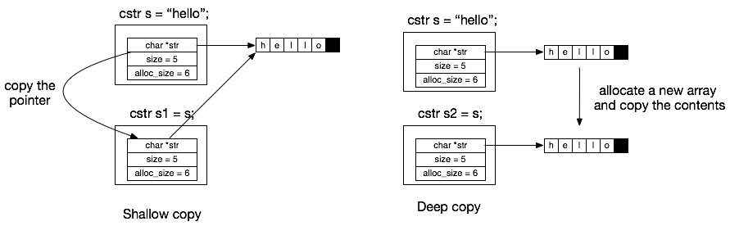
Shallow copy vs. deep copy
If your object contains a pointer/reference to object X, then you have to ask:
Should the new object share X with the current object, or should it get its own copy of X?
Shallow copy: use the same X
Deep copy: make a copy of X, necessary if, for example, X gets destroyed by the object’s destructor
This means you have to make a copy of all pointed-to/referenced objects
cstr needs a deep copy, because each object should have its own copy of the string to destroy

Slide 8
Copy constructor for cstr
Re-implement the copy constructor for cstr so that it makes a deep copy of the array and its contents.

Slide 9
3. Linked List
ECE 309
Dr. James Tuck

Slide 10
Objectives
Introduction to data structures
Define linked list (review) and draw a picture of one
Describe some of their common operations: append, insert, removal
Implement a linked list in C++

Slide 11
Data structures
A data structure is a way of organizing data, usually with a set of operations that can be performed on them
When designing data structures, we strive for efficiency in terms of compute time and memory used

Slide 12
Data structures
It turns out that most ways of organizing data boil down to a few common structures:
Arrays, lists, graphs, trees, hash tables

Slide 13
The List
A list is common abstract data type for holding ordered data, and it typically has operations like:
Append a data item to the list
Remove a data item from the list
Search for an item in the list

Slide 14
Example: a grocery list
The data: an ordered list of things you want to buy like milk, cereal, chips, coffee, toothpaste
When using a grocery list data structure, you probably:
Add new items to the list,
Remove item from the list (when you buy it),
Get the next item on the list while shopping,
Search the list for a specific item that might be on the same row

Slide 15
A simple C++ object for a List
//incomplete class declaration
class List {
public:
List();
void append(Item a); // append to end
bool remove(Item &a); // remove front
bool empty(); // check if empty
};

Slide 16
Example of List operations
Operation | Conceptual Result (show list in braces) | Explanation
List l; | {} | Start with an empty list
l.empty() | true | List is empty
l.append(“eggs”) | {eggs} | Put eggs at end of list
l.append(“bread”) | {eggs, bread} | Add bread to end of list
l.remove() | Returns eggs, list becomes {bread} | Remove front of list
l.empty() | false | bread is still in the list

Slide 17
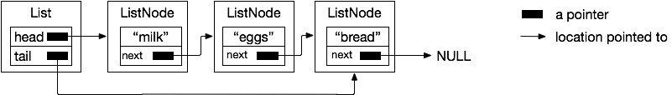
Linked List
A linked list is a data structure commonly used for implementing a list:
Items in the list are linked together through pointers.
Singly-linked list: one pointer connects adjacent items, unidirectional.
Linked lists can be of arbitrary size
We need to keep track of the head and/or tail pointer to the list.

Slide 18
The C++ objects we need
// ListNode represents each node of the list
class ListNode {
public:
Item item; // data in the list
ListNode *next;
ListNode(Item a)
{ item = a; next=NULL; }
};
class List {
private:
// add head and tail pointer
ListNode *head;
ListNode *tail;
public:
List();
void append(Item a);
bool remove(Item &a);
bool empty();
};

Slide 19

List::List (the default constructor)
// Initialize List to be empty
List::List()
{
// there’s nothing in the list
head = nullptr;
tail = nullptr;
}

Slide 20


List::append
void List::append(Item a)
{
ListNode *node = new ListNode(a);
if (head==nullptr) {
// list is empty, so set head and
// tail to be node
head = node;
tail = node;
} else {
// put new node at end of list
tail->next = node;
tail = node;
}
}

Slide 21

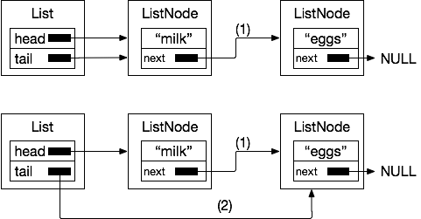
List::append
void List::append(Item a)
{
ListNode *node = new ListNode(a);
if (head==nullptr) {
// list is empty, so set head and
// tail to be node
head = node;
tail = node;
} else {
// put new node at end of list
tail->next = node; //(1)
tail = node; //(2)
}
}

Slide 22
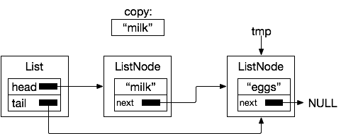
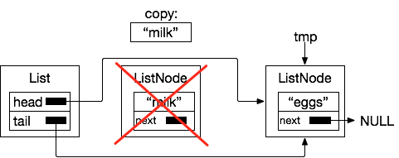
List::remove
bool List::remove(Item &copy)
{
if (!empty()) // if list is not empty
{
copy = head->item; // return copy
ListNode *tmp = head->next;
delete head; // delete the node
head = tmp; // update the head
if (tmp==NULL) // removed last element
tail = NULL;
return true;
}
return false; // nothing in list
}

Slide 23
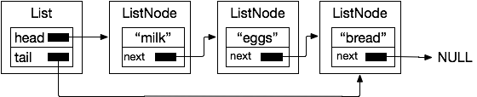
List::empty
bool List::empty()
{
// if head is NULL, list is empty
return head==nullptr;
}
Empty!
Not empty!

Slide 24
Example
Use the List object to make a list of strings and print them out.
List l;
l.append(Item("milk"));
l.append(Item("eggs"));
l.append(Item("bread"));

Slide 25
Refining the C++ code a bit
The ListNode object is only used by the List object.
Can we guarantee that no other part of the code uses the ListNode class other than List?
Answer: Yes, make the class declaration a private member of List.

Slide 26
ListNode as a private member of List
class List {
private:
// ListNode represents each
// node of the list
class ListNode {
private:
Item item; // data in the list
ListNode *next;
ListNode(Item a) { item = a; }
};
// add head and tail pointer
ListNode *head;
ListNode *tail; // continued on next column.
public:
List();
void append(Item a);
bool remove(Item &a);
bool empty();
}; // end class List

Slide 27
What happens when the List is destroyed?
Currently we have no class destructor
We leave behind all the ListNode objects in memory
We should fix the destructor to deallocate all of the ListNodes

Slide 28
List::~List()
List::~List()
{
// Free all of the ListNodes in the list
Item t;
while(!empty()) // while not empty
remove(t); // remove the next node
}

Slide 29
Complexity of Linked List operations
Operation (assume List of length n) | Time Complexity | Explanation
append to tail | O(1) | The append function has no loop. It allocates a new node and updates two pointers. This time cost is fixed to a few statements. Since it’s constant number of operations, it’s O(1)
remove from head | O(1) | Similar argument for appending. O(1)
empty | O(1) | Checking the head for NULL has a fixed cost.
deletion of list of length n | O(n) | Traversing a linked list and deleting each node requires at least one getNext() operation for each item in the list. O(n)

Slide 30
Summary
Designed a singly-linked list that can hold a list of strings
We designed three objects: List, ListNode, and Item
Item simply holds a pointer to a string
List and ListNode cooperate to make the List work
We make ListNode a private member of List to restrict its use to within List

Slide 31
References
1. ZyBook on Data Structures, chapters 11.1-11.4, 11.10

